Slide 1
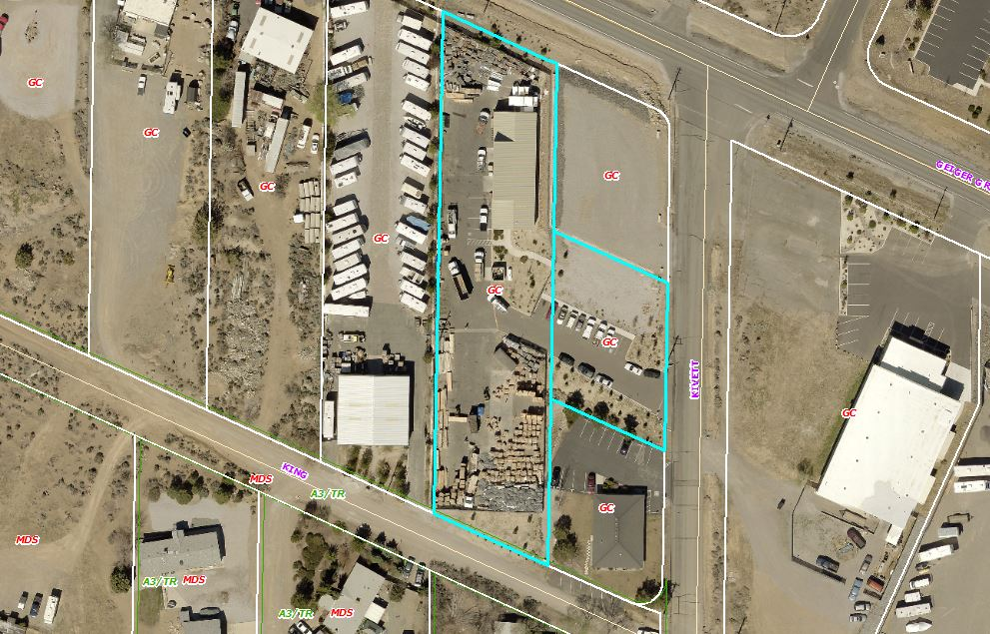
Special Use Permit WSUP18-0021
Washoe County
Board of Adjustment
February 7, 2019
SonRay Construction
(aka Sonoran Roofing)

Slide 2
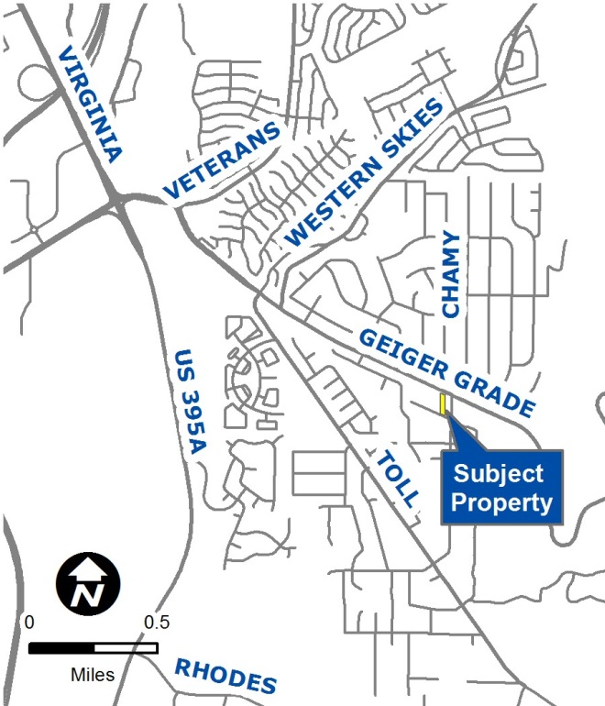
Vicinity Map
1565 Geiger Grade
Accessed off of Kivett Lane
General Commercial
2 parcels (±1.33-ac.)

Slide 3
Overview of Request
Existing Construction Sales & Services use
  Roofing and HVAC contractor
Previous special use permit issued in 2005
Expansion triggers re-review
Existing 3,636 sq. ft. metal storage building would be expanded by 3,570 sq. ft.
Store construction materials and equipment

Slide 4
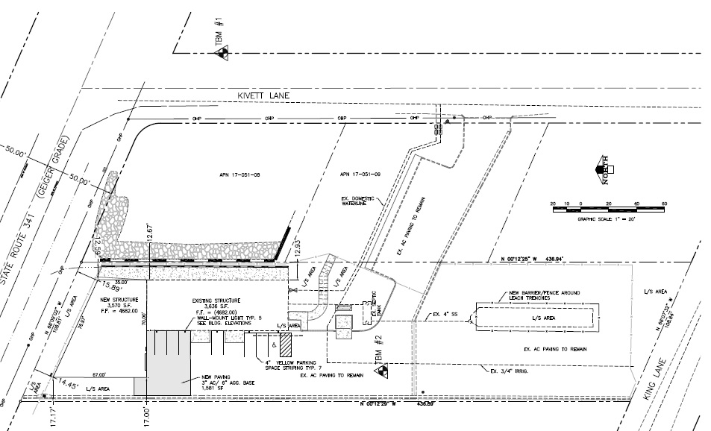
Site Plan
LEGEND
Project site (2 parcels)
Area of proposed building expansion
KIVETT LANE
GEIGER GRADE
KING LANE

Slide 5
Aerial Photo

Slide 6
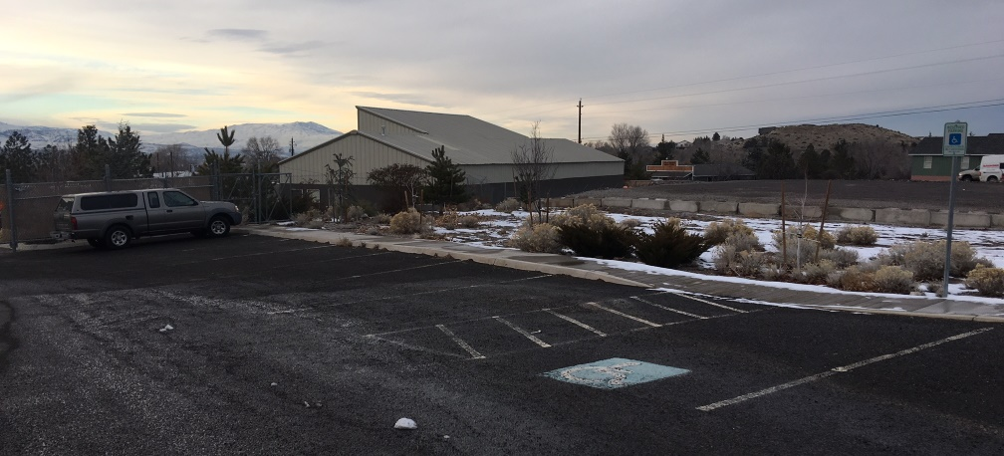
Site Photo

Slide 7
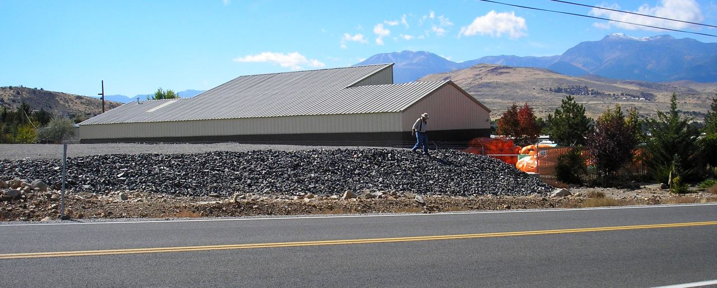
Site Photo

Slide 8
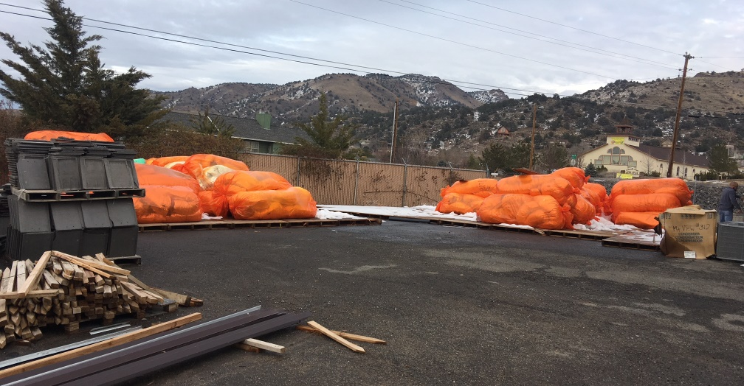
Site Photo

Slide 9
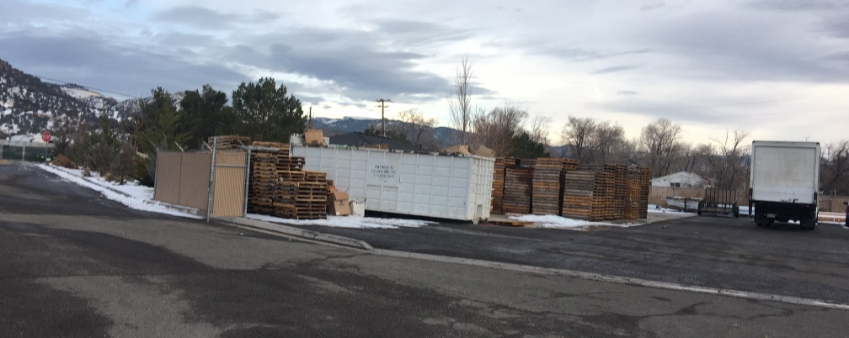
Site Photo

Slide 10
Project Details
Construction material stored outside will be brought inside, with exception of existing pallet storage
Access: From Kivett Lane
Traffic: None additional; 5 employees based on-site; max. 12 on-site at any given time
Standards for parking, landscaping, lighting, must be met for entire site

Slide 11
Aesthetic Considerations
Building expansion will help screen operation from Geiger Grade
Slatted chain-link around perimeter
Previous conditions of approval will apply:
  Color and building materials of north & east sides of addition to match existing structure; color match only on south & west
New conditions of approval for expansion will be added to existing conditions from 2005

Slide 12
Citizen Advisory Board (CAB)
Jan. 3: South Truckee Meadows/Washoe Valley CAB
No questions/comments
CAB voted unanimously to recommend approval

Slide 13
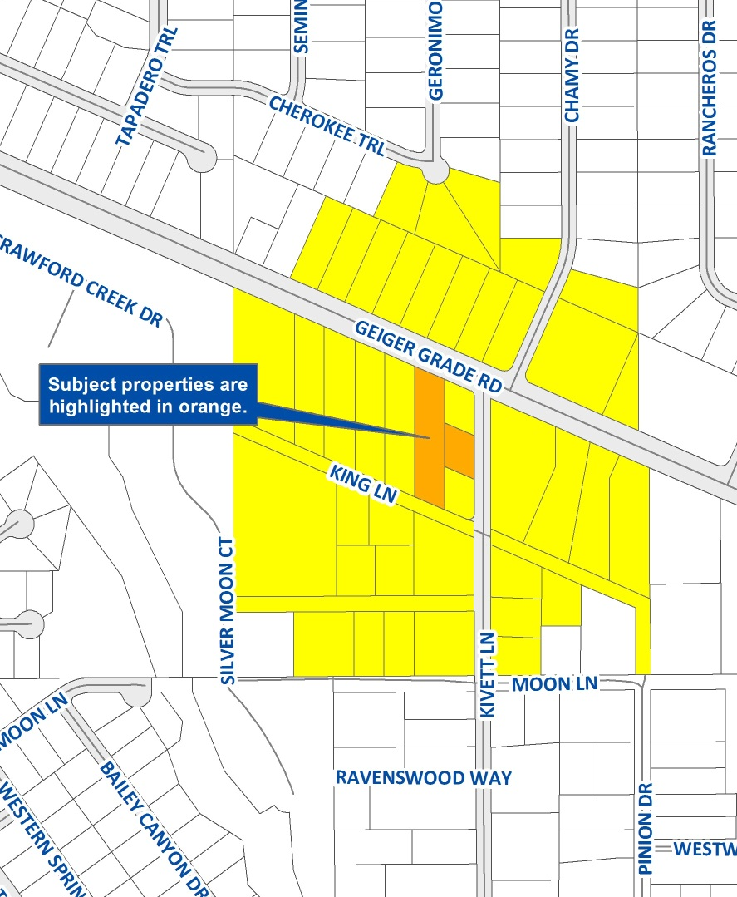
Public Notice
Notice provided to 38 owners of 45 parcels within 500-ft.

Slide 14
Reviewing Agencies
Washoe County Community Services Department
  Planning and Building
  Engineering and Capital Projects
  Utilities/Water Rights
Truckee Meadows Fire Protection District
Washoe County Health District
Regional Transportation Commission
Truckee Meadows Water Authority
AT&T and NV Energy
Washoe-Storey Conservation District

Slide 15
Required Findings
Consistency
Improvements
Site Suitability
Issuance not Detrimental
Effect on a Military Installation
Air Quality (SET.11.3)
Recommendation: Approval with conditions

Slide 16
Possible Motion
I move that, after giving reasoned consideration to the information contained in the staff report and information received during the public hearing, the Washoe County Board of Adjustment approve, with the conditions attached as Exhibit A, Special Use Permit Case Number WSUP18-0021 (previously known as SB05-014) for SonRay Construction, having made all six findings in accordance with Washoe County Code Section 110.810.30 and Southeast Truckee Meadows Area Plan Policy SETM.11.3.

